Slide 1

Managing Households

Slide 2

What is a Household?
For HUD and HMIS purposes, a household is defined as an individual or group of people who share housing.
This can be an individual or a group of individuals who are related or unrelated, as in a family or roommates.
In HMIS creating a household allows data to be related among a group of client records.
Grouping clients as a household allows you to create one Entry, one ROI, one Interim, one Exit, and so on, including all members of the household.
Households will always only have one Head of Household identified and all other household members will have a chosen relationship to Head of Household.

Slide 3

How to Start a New Household

Slide 4
Add New Client(s)
If the client cannot be found in HMIS after using the funnel technique to search the database….
Input all information into search page
Be sure to answer all questions & pulldown menus
Click “Add New Client With This Information” button
Enter the first few letters of first & last name and search the database to see if there is an existing profile, if not found…

Slide 5
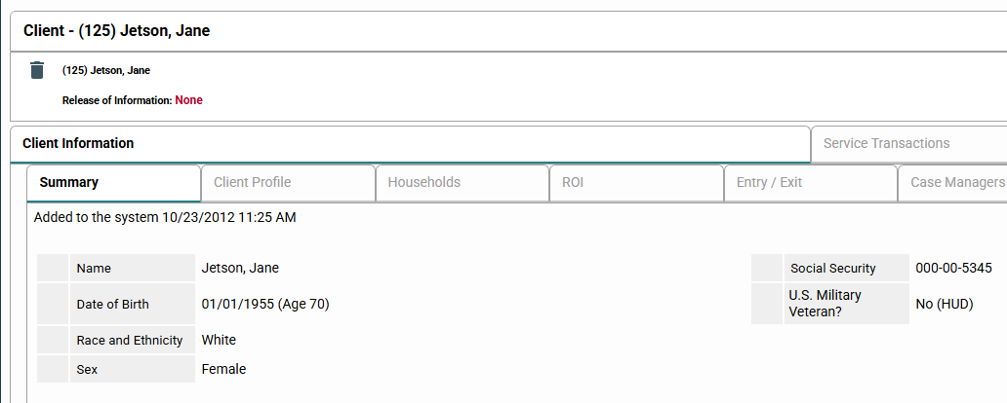
If the Client is Already in HMIS
Log into HMIS and open the client profile.

Slide 6
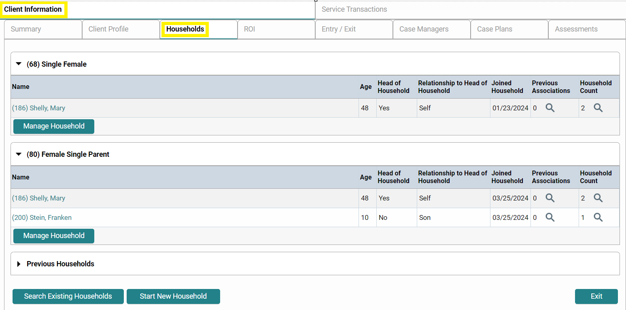
Navigate to Client Information and
Open the Household Tab to Manage Household or Start a New Household Depending on the Client’s Situation.

Slide 7
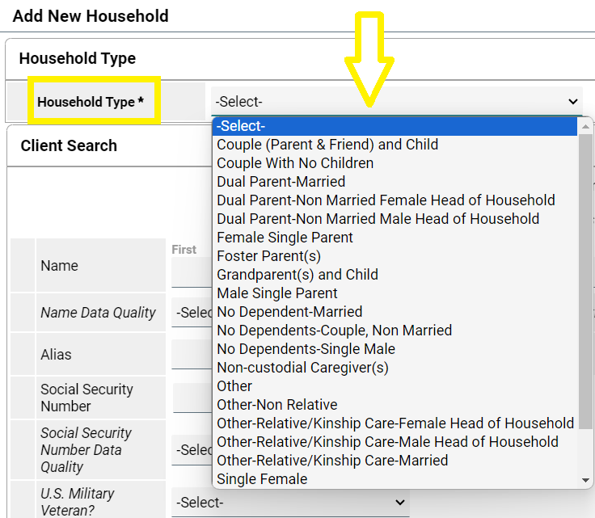
Create New Household
Select the household type from the drop-down list

Slide 8

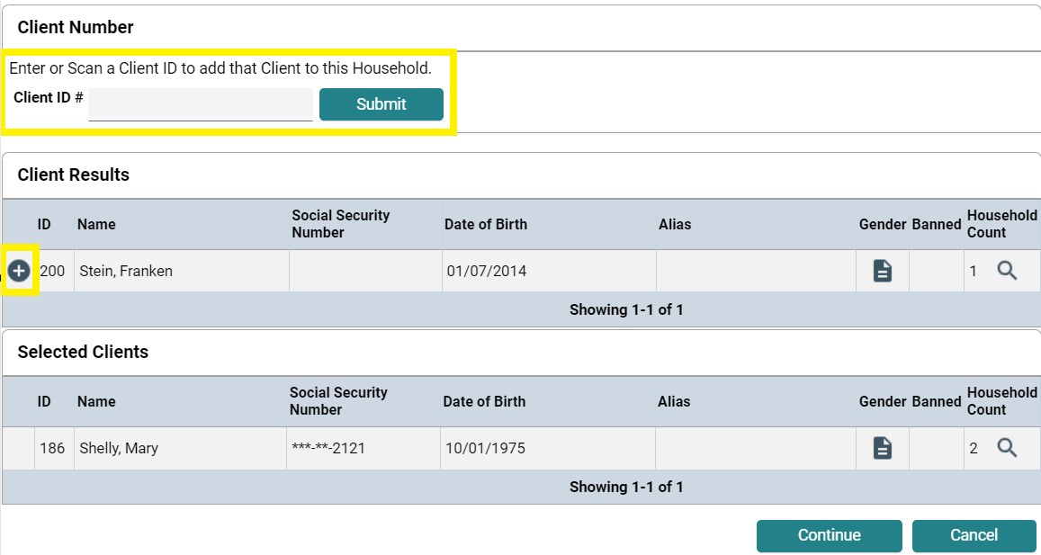
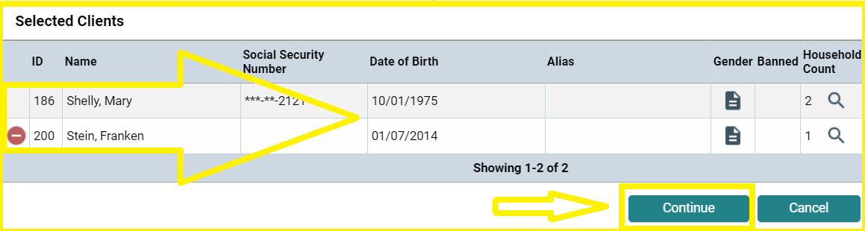
Verify Household Members
Scroll down until you see a field to enter a Client ID number. Enter the HMIS ID# for each member of the household (one at a time) and click the . To add each member of the household.
          You should now see each member of the household in the Selected Clients section. If all household members are correctly listed, click Continue.

Slide 9
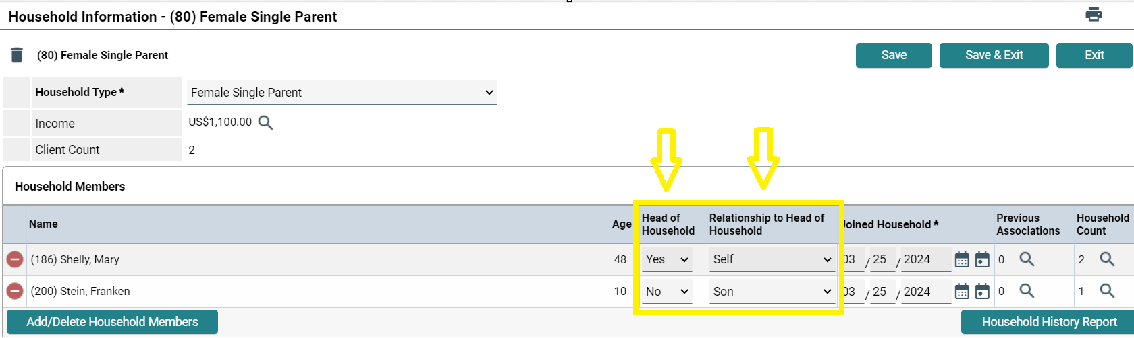

Designate Head of Household and Relationship to Head of Household for all members.
In the next screen, select the appropriate answer from the Head of Household and Relation to Head of Household drop-down menus for all household members.
Scroll to the bottom and click Save & Exit.

Slide 10

How to Update Household Size

Slide 11
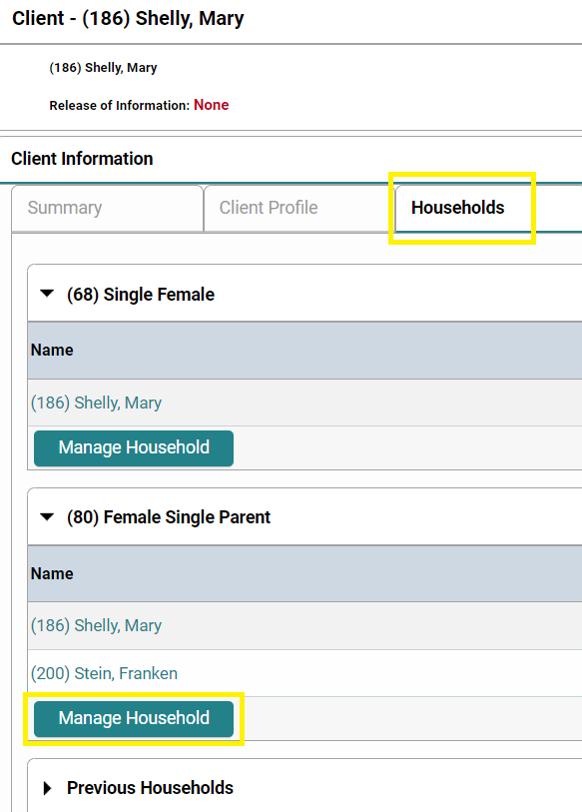
Navigate to Household
Log into HMIS and click on "Client" in the left-hand column of the screen. Scroll down to the box shown here, enter the Head of Household's HMIS ID#, and click submit.
Click into the Household Tab, never update any information on the Summary Tab.
Click on Manage Household to edit.

Slide 12
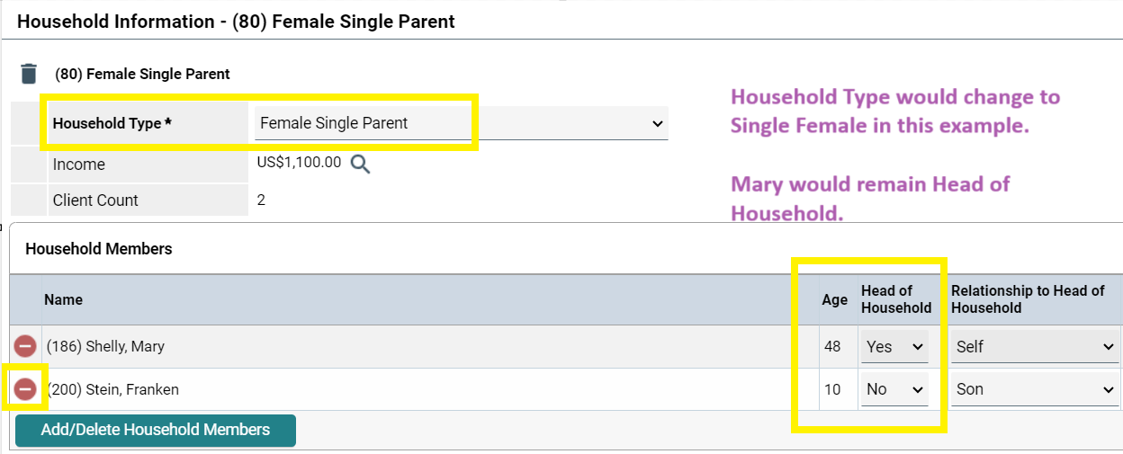
Delete a Household Member
To delete a member, click on the red minus sign. You will then be prompted to enter the date the client left the household.
Don’t forget to update the Household Type and Relationship to Head of Household if needed.
Scroll to the bottom and click Save & Exit.

Slide 13
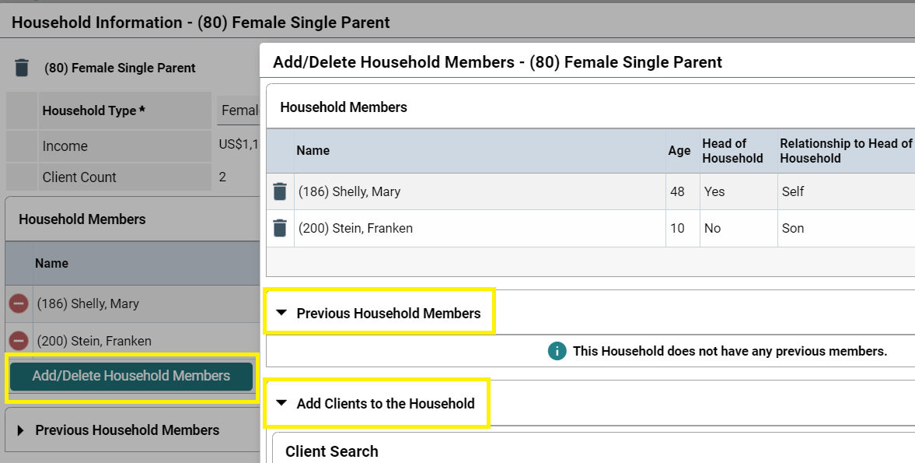
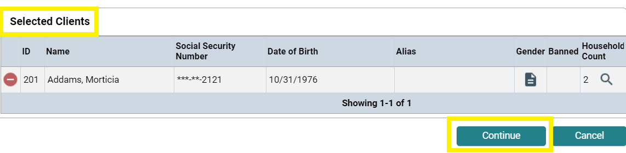
Add a Household Member
To add a member, click on the Add/Delete Household Member button. A new box will pop up on your screen.
You may choose from Previous Household Members or Add Clients to the Household.
Enter Client ID if know, Perform Client Search, or Add new Client depending on the Household situation.
You will see the Selected Clients you are adding to the Household at the bottom of the screen. Click Continue.
Again, be sure to always verify or updated the Household type, Head of Household and Relationship to head of household.

Slide 14
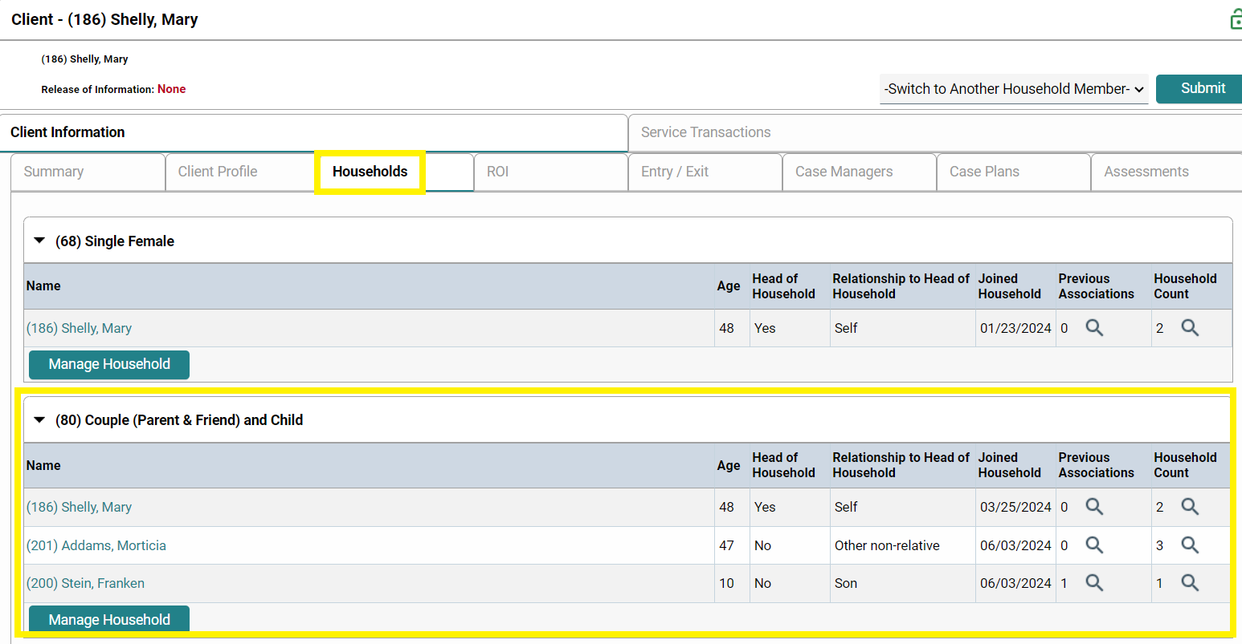
Confirm Household Type & Relationship to Head of Household

Slide 15

Please reach out to HMIS https://pinellashmis.zendesk.com/hc/en-us/requests/new
Questions?

