Slide 1
Veteran Status
Data Entry Guide
July 2021

Slide 2
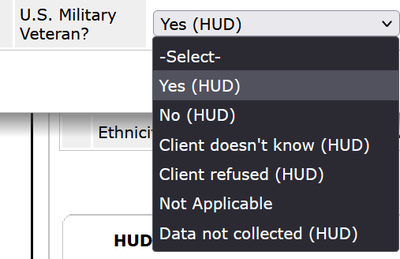
Veteran Status Data Entry
Select the appropriate answer for the client’s Military Veteran status. Data not collected should never be chosen.
This field must be answered for all adults (18 or older)

